Slide 1
Data SQL Ninja Engineering Team
Workload Assessment Tool
Overview and Guidance
Data SQL Ninja Engineering Team

Slide 2
Overview of Tool
Provides suggested “best fit” target platforms, cloud readiness and application/database remediation level for a given workload based
Calculation is based on a set of 41 questions across 12 categories
Each of the 41 questions has a prescribed set of possible answers based on drop-down controls
Built using Excel and VBA. Provides a simple, one-click calculation and report generation
Greatly helps to accelerate large estate assessments by providing automated and uniform target platform decision process
Generated report can be placed into assessment findings decks for migration assessment engagements
Can provided structured approach and process for customer migration workshops
Data SQL Ninja Engineering Team

Slide 3

Report Considerations
Target platforms considered include:
On-Premises
SQL Server
SQL Server On Linux
Azure
SQL Server IaaS
SQL Server On Linux IaaS
Azure SQL DB
Azure SQL DB – Elastic Pools
Azure SQL Managed Instance
Azure SQL Data Warehouse
Application and Database Level of Remediation Levels include:
Very Simple: App and database can be moved into target workload with minimal translation and re-write
Simple: Some application code updates and database object conversion
Moderate: Data Access Layer re-work on application, non-trivial database object conversion
Extensive: Substantial application code re-writing and data access layer code updates. Plus substantial database object conversion and translation.
Data SQL Ninja Engineering Team

Slide 4
Calculation Methodology
For each workload, at the start of the calculation process, it is assumed any platform is possible
Each question will impact the predicted feasibility of each target platform and update the overall feasibility of a given target platform for a given workload
The same logic is used for remediation as well. The tool assumes at the start that the workload will be a lift and shift, then as it runs through the question analysis, the overall remediation will be increased based on the answers to certain questions.
The lower the number, the more feasible that platform is
Calculated numbers range from 0 (most feasible) to 3 (least feasible)
Data SQL Ninja Engineering Team

Slide 5
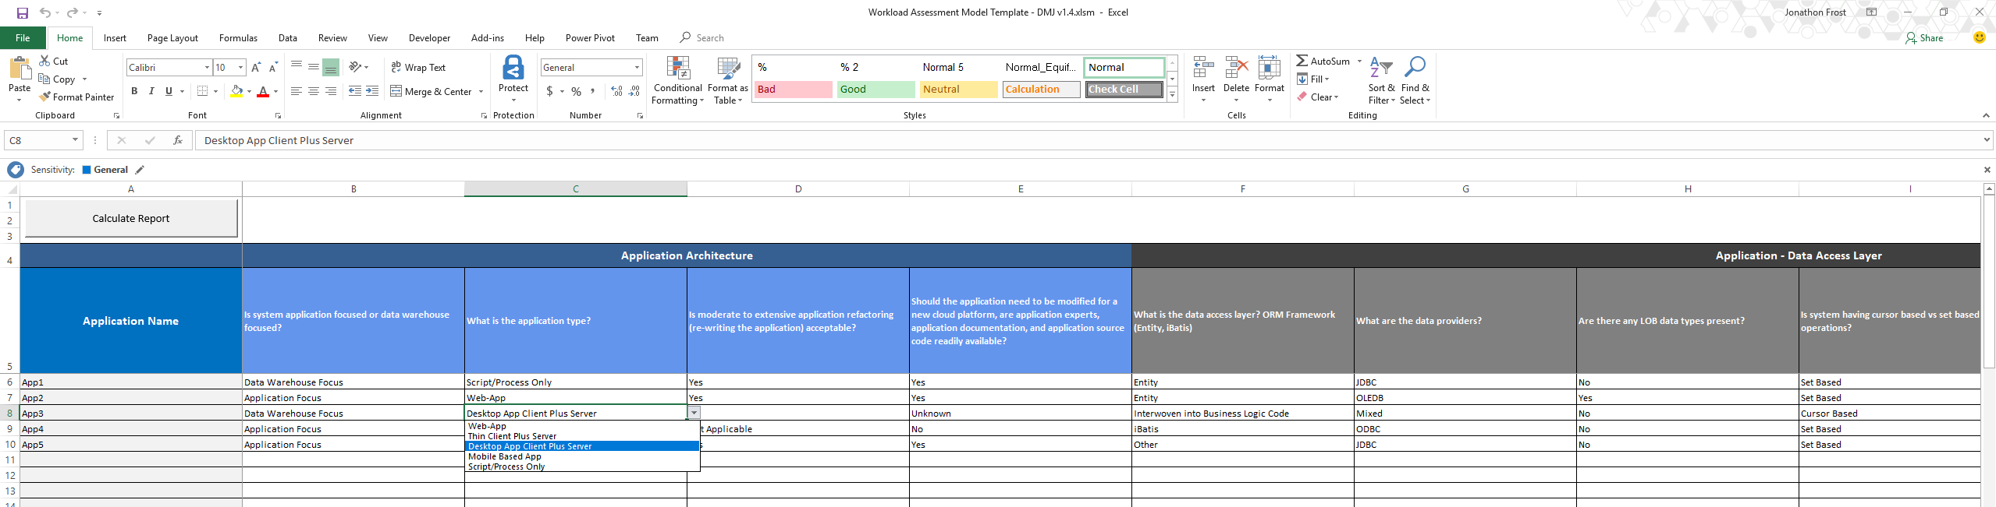
Question Sheet Example Screen Shot
Data SQL Ninja Engineering Team

Slide 6
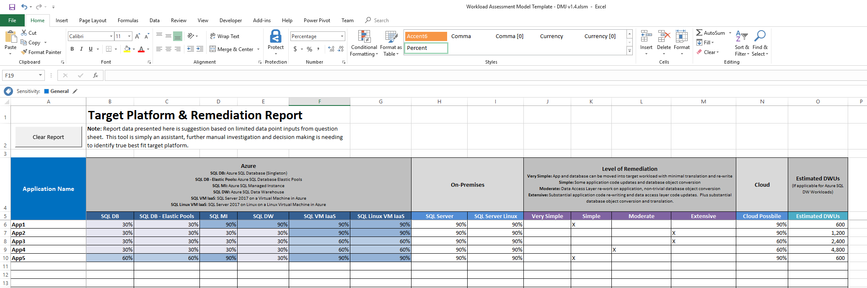
Automated Findings Report Dashboard Example Screen Shot
Data SQL Ninja Engineering Team

Slide 7
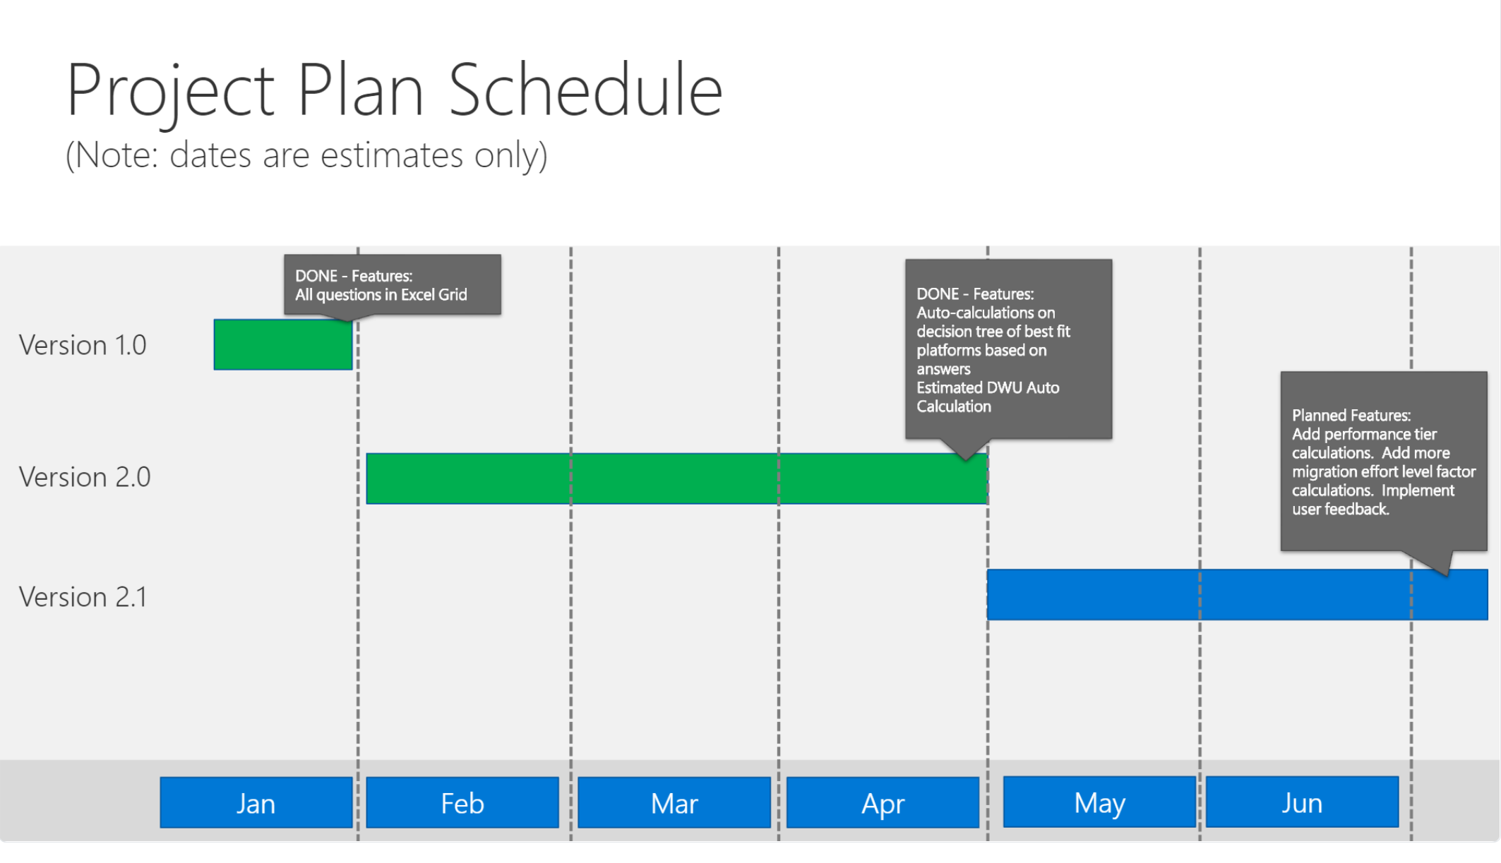
Data SQL Ninja Engineering Team

